Slide 1
China Kunming golf
Keppel Land Hospitality Management

Slide 2
Contents
Getting Here
Weather & Golfing Time in Kunming
Spring City Golf & Lake Resort
About Kunming Golf
Award Winning Courses
Packages
Tourist Attractions & Spa

Slide 3
Getting here
Keppel Land Hospitality Management

Slide 4
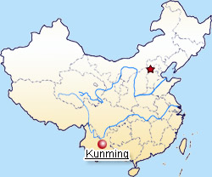
Getting there
South-West of China
2.5 hours flight from Hong Kong/
Guangzhou Shenzhen
3.5 hours flight from Beijing / Shanghai
Kunming Airport is the largest single terminal in Asia and 4th largest airport in China
Direct flights from Bangkok, Chiang Mai, Singapore, Kuala Lumpur, Seoul, Hong Kong, Taipei, Kaohsiung, Yangon, Mandalay, India & Bangladesh.

Slide 5
Bangkok, Singapore & Hong Kong Connecting flights to Kunming
Bangkok to Kunming (2 hours)
Thai Airways (TG) | China Eastern Air (MU)
Daily, TG612, 10:50 / 14:05 | Daily, MU742, 15:45 / 18:20
Singapore to Kunming (4 hours)
Silk Air | China Eastern Air
Mon/Thu/Sun: MI912, 08:20/12:20 | MU5094: 03:00 / 06:55
Tue/Fri: MI916, 11:10/15:10
Hong Kong to Kunming (2h30mins)
Hong Kong Express | China Eastern Air
HX277, 09:05/11:30 | MU734, 17:05/19:10
HX275, 16:45/19:15
Hong Kong Dragon Air
KA760, 11:55/14:20

Slide 6
Domestic Major Cities Flights (Guangzhou – Kunming)
2 hours 30 mins flight time
06:50 / 09:10 | 07:20 / 09:55 | 07:40 / 09:50 | 08:40 / 11:05
10:55 / 13:25 | 11:25 / 14:00 | 12:05 / 14:30 | 12:45 / 15:20
13:45 / 16:15 | 15:55 / 18:30 | 18:25 / 21:00 | 18:55 / 21:25
19:00 / 21:35 | 20:05 / 22:30 | 22:00 / 00:20 | 21:40 / 00:05

Slide 7
Domestic Major Cities Flights (Shanghai – Kunming)
From PuDong International Airport (3 hours 30 mins)
10:40 / 13:55 | 13:25 / 16:50 | 14:20 / 17:45 | 15:00 / 19:25
21:05 / 00:35
From Hong Qiao Domestic Airport (3 hours 30 mins)
07:25 / 10:55 | 07:30 / 10:55 | 08:25 / 11:50 | 09:05 / 12:25
11:45 / 15:10 | 11:50 / 15:20 | 13:25 / 16:45 | 14:25 / 17:50
15:10 / 18:20 | 15:50 / 19:10 | 18:55 / 22:15 | 20:20 / 23:50
21:00 / 00:20

Slide 8
Domestic Major Cities Flights (Beijing – Kunming)
From Beijing International Airport (3 hours 30 mins)
06:40 / 09:55 | 07:25 / 10:40 | 07:55 / 11:20 | 08:05 / 11:40
08:20 / 11:45 | 08:30 / 11:50 | 09:05 / 12:30 | 09:10 / 12:35
11:55 / 15:20 | 12:25 / 15:40 | 12:55 / 16:20 | 14:15 / 17:40
15:35 / 19:00 | 15:40 / 18:55 | 16:20 / 19:50 | 18:15 / 21:35
20:35 / 23:55 | 21:05 / 00:25 | 21:25 / 00:50

Slide 9
Domestic Major Cities Flights (Chengdu – Kunming)
From Chengdu International Airport (1 hour 20 mins)
06:50 / 08:10 | 07:25 / 08:45 | 07:30 / 08:50 | 07:55 / 09:10
08:40 / 09:55 | 09:45 / 11:05 | 11:15 / 12:45 | 11:20 / 12:40
15:40 / 16:55 | 18:45 / 20:15 | 19:55 / 21:20 | 21:10 / 22:30
22:40 / 23:55 | 22:50 / 00:20

Slide 10
Excellent Spring-like Weather all year-round
The average temperature in Kunming ranges between
15°C (morning & night) to 20°C (afternoon).
These excellent climate conditions have won Kunming the deserving name of “Spring City” where golfers enjoy their Spring-like weather games all year round.
Season | Month | Morning Temperature | Afternoon Temperature | Last Light
Spring | Mar -May | 14 – 19 °C | 19 - 23 °C | 7.30 pm
Summer | Jun – Aug | 18 - 20 °C | 22 - 25 °C | 8.30 pm
Autumn | Sep – Nov | 13 - 18 °C | 17 - 21 °C | 6.45 pm
Winter | Dec – Feb | 08 - 11 °C | 13 - 16 °C | 6.45 pm

Slide 11
Spring City Golf & Lake Resort

Slide 12
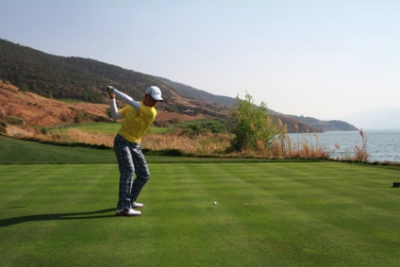
Guan Tian Lang (the Kid) prepares for Masters in Spring City (fastest green speed in Asia)

Slide 13
Spring City Golf & Lake Resort (Accolades)
US Golf Digest
Top 100 courses outside USA (2012, 2010, 2008)
US / China Golf Magazine
World Top 50 Golf Courses
Best Service Golf Club (China)
Best Turf Award (China)
Best Caddie Service Golf Club (China)
Asian Golf Monthly
Best Course in Asia & China (Asian Golf Monthly)
Fun Fun Golf (Largest Golf website in China)
Gold Medal Course for Service (China)
Plus 100+ international and China golf awards

Slide 14
Renovation of hotel building & new golf building

Slide 15
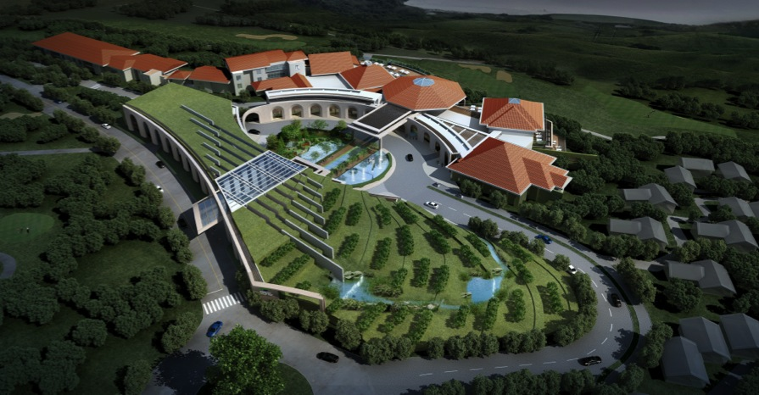
New Golf Building

Slide 16
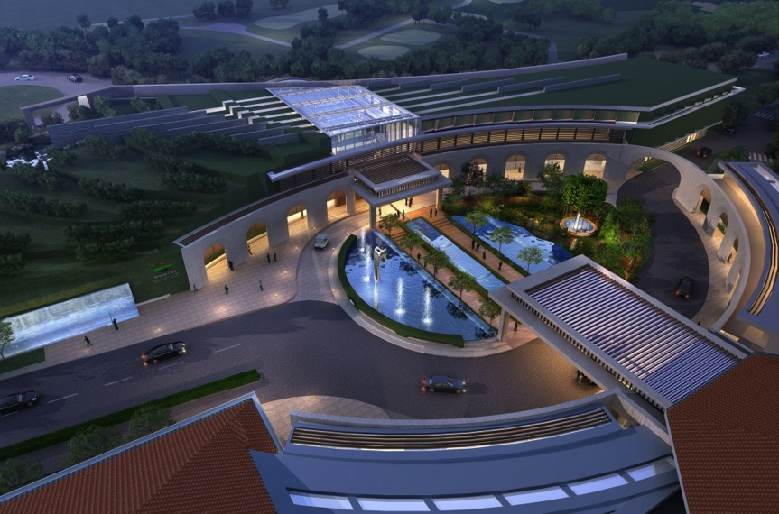
Night view of the 2 new buildings facade

Slide 17
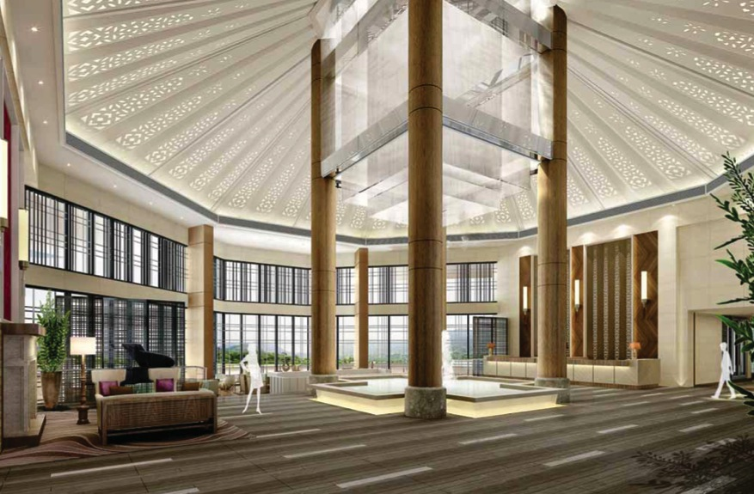
New Lobby

Slide 18
Spring City - Facilities
2x18 holes award-winning Championship course, designed by Jack Nicklaus (Mountain Course) and Robert Trent Jones Jnr (Lake Course)
Fasting Green in China (13’ in Dec-Feb)
73 golf lodges and 200 villas
Main restaurant (Eagle Nest) serving Oriental and Western cuisines (ready end Aug 2013)
Outdoor terrace (250 seating capacity), ready end Aug 2013
7 private dining rooms (ready end Aug 2013)
Outdoor Par Cafe
2 tennis courts
4 KTV rooms
4 cards room

Slide 19
Our partners (kunming golf consortium)
Keppel Land Hospitality Management

Slide 20
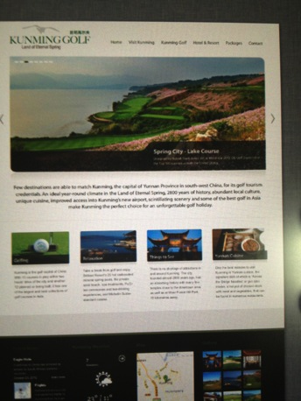
www.golf-kunming.com
Website formed in Oct 2012 with 5 golf courses, 1 Spa Resort and 2 local Inbound Agents, created and hosted by Australian web media, Mr Paul Myers.
Excellent website with each partner’s product information, Kunming attractions, golf packages all under 1 roof.

Slide 21
Golf Courses in Kunming
There are 16 golf courses in Kunming currently, with another 10 to open in 12-18 months time.
Our Kunming golf consortium is represented by 4 top quality clubs with 7 golf courses.
Golf Clubs (holes) | Designer (Holes) | Characteristics / Accolades | Travelling Time
Spring City Golf & Lake Resort (36) www.springcityresort.com | Jack Nicklaus Robert Trent Jones Jnr | 1) Golf Digest Top 100 courses outside USA 2) Best Course in Asia & China and 100+ more awards | 50 mins from airport
Stone Forest International Country Club (36) www.stoneforestgolf.com | Brian Curley | Top 10 most Outstanding New Golf Course in China. Located within the world’s “8 natural wonder landscapes”. Layered Karst Landform. | 50 mins from Spring City Golf
Hong He Golf Club (18) www.hhspring.net | Hao Jian Biao | Most challenging course in Kunming, follow contour of natural mountain | 50 mins from Stone Forest
Sky Oasis Golf Club (36) | Cynthia Dye E&G Parslow | Eagle Hole | 2 hours from airport

Slide 22
Kunming Golf Consortium
Spring City – Lake Course | Spring City – Mountain Course | Sky Oasis – Eagle Hole
Stone Forest A Course | Stone Forest B Course | Hong He Golf Course

Slide 23
STONE FOREST INTERNATIONAL COUNTRY CLUB

Slide 24
Hong He Golf Club

Slide 25
Sky Oasis (Eagle Hole)

Slide 26
Li Jiang (1 hour flight from Kunming)

Slide 27
Brilliant Spa (Natural Hot Spring Water)

Slide 28
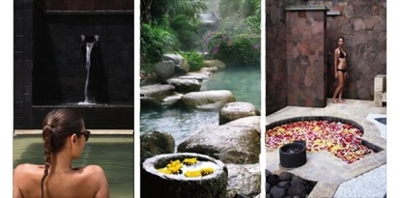
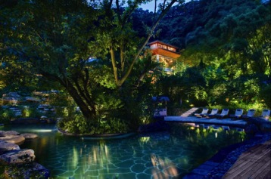
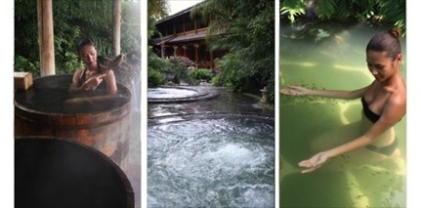
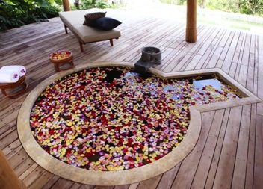
Brilliant Spa Resort (10 mins from Spring City)

Slide 29
Ready packages
Keppel Land Hospitality Management

Slide 30
Package Types
Short Haul
3 – 5 days (3-4 rounds)
Spring City and Stone Forest
Ideal for twin-destination packaging with other China cities (Shenzhen/Hainan) or with Thailand
Medium Haul
5-7 days (4-6 rounds)
Golf around Kunming
Long Haul
8-13 days (7-11 rounds)
Kunming + LiJiang

Slide 31
attractions / spa
Keppel Land Hospitality Management

Slide 32
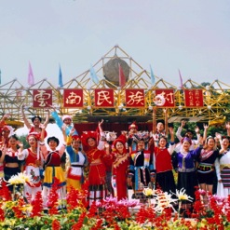
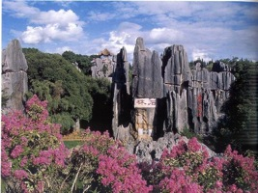
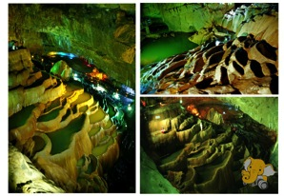
Attractions
Stone Forest Scenic Spot | Jiuxiang Scenic Area | Yunnan Nationalities Village
This 400 km2 area has been a UNESCO World Heritage Site since 2007. The Stone Forest is famous for its karst landforms and ethnic culture. The limestone erodes and subsides, resulting in various topographic formations. The Stone Forest was formed in the Permian Period 270 million years ago. | 90km from Kunming downtown and 30km from the Stone Forest. It is famous for its underground karst caves, intoxicating natural landscapes. Formed in the Sinian Period some 600 million years ago, the Jiuxiang karst cave cluster comprises more than 100 caves. | There are 26 minority tribes in Yunnan and this village will showcase all of them and its rich cultural heritage.

Slide 33
Brilliant Spa Resort (10 mins from Spring City)

